Slide 1
The Normal Distribution, Part 1
Nina Gunnes
November 11, 2021

Slide 2
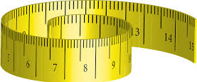
Continuous variables
https://www.maxpixel.net/Yellow-Distance-Measure-Tape-Measure-1224958
Resulting from measurements on a continuous scale
Any single point on the scale being a possible value
Infinitely many points
Operating with rounded values in practice
Three main data types
Non-negative data (e.g., body weight, age, and blood pressure)
Interval-limited data (e.g., percentage of drug absorption)
Unlimited data (e.g., change in body weight and change in blood pressure)

Slide 3
Probability density function
Expressing the probability distribution of a continuous variable $X$
A function $f\left(x\right)$ satisfying three requirements
$f\left(x\right)≥0$ for all possible values $x$
Total area under the function curve equal to 1
$P\left(a≤X≤b\right)$ equal to the area under the function curve from $a$ to $b$
Probability of $X$ being close to $x$ obtained by narrowing the interval
Choosing $a$ and $b$ very close to each other around $x$
Height of the curve at point $x$ proportional to the probability

Slide 4
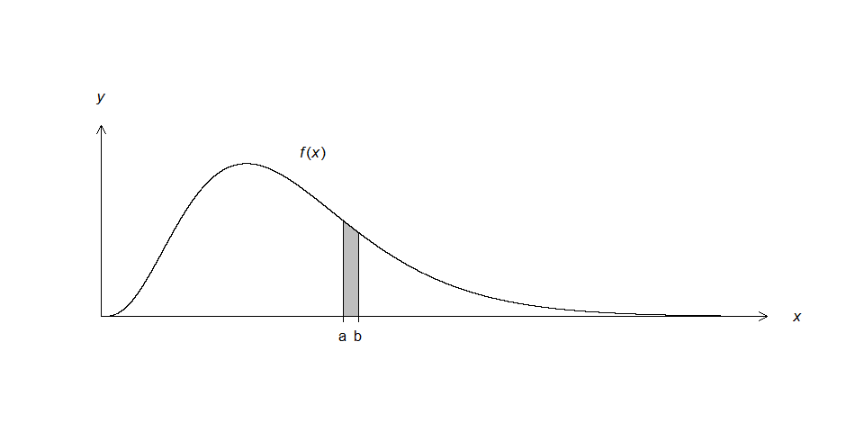
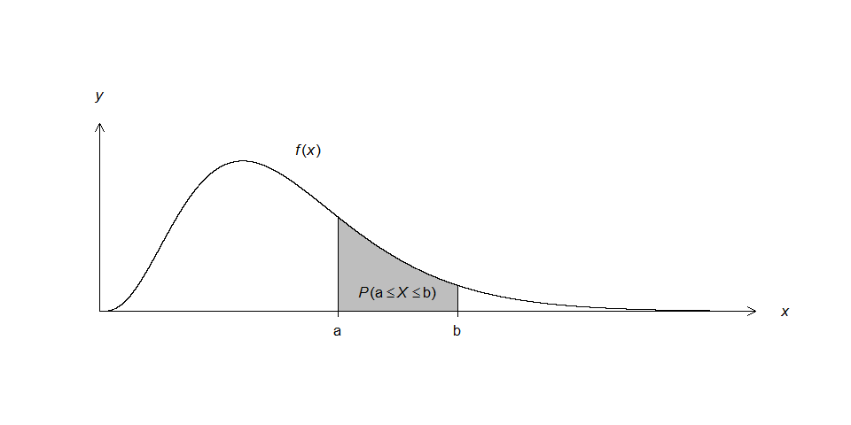
Probability density function, cont.

Slide 5
Probability density function, cont.
Frequency of values of $X$ depending on the height of the curve
Values more frequently observed where the curve is high
Values less frequently observed where the curve is low
Closely linked to histogram
Probability density function giving the probability distribution in a population
Histogram showing the probability distribution in a sample of a population
Median obtained directly from the curve
Point on the $x$ axis dividing the area under the curve in two equal parts

Slide 6
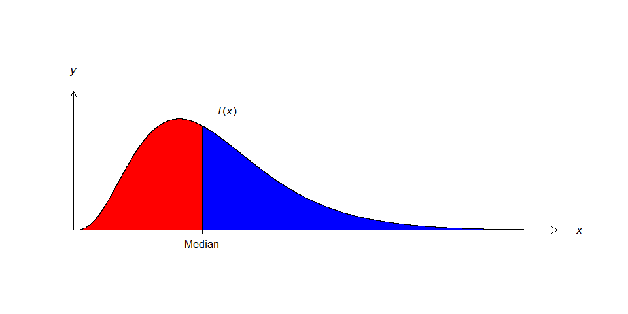
Probability density function, cont.
Area under the curve: 0.5
Area under the curve: 1
Area under the curve: 0.5

Slide 7
Probability density function, cont.
Mean and variance defined as limits of their empirical counterparts
Calculating the empirical mean and the empirical variance in a sample
Constantly increasing the sample size
Repeating the calculations after every increase
Approaching limits of the empirical mean and the empirical variance
Mean (i.e., expectation or expected value) of $X$ denoted by $\text{E}\left(X\right)$
Variance of $X$ denoted by $\text{Var}\left(X\right)$
Standard deviation of $X$: $\text{SD}\left(X\right)=\sqrt{\text{Var}\left(X\right)}$

Slide 8
Normal distribution
The most important probability distribution in statistics
Appearing in several contexts
Many useful properties
Two important roles
Probability density function for some continuous variables
Approximation to the binomial distribution and the Poisson distribution
Nice-looking bell-shaped curve
Perfectly symmetrical around the mean
http://pngimg.com/download/53584

Slide 9
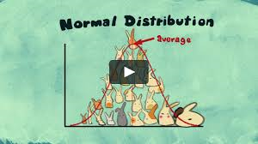
Normal distribution, cont.
Normally distributed variable $X$: $X\sim \text{N}\left(μ,σ\right)$
Mean (i.e., expectation or expected value): $\text{E}\left(X\right)=μ$
Standard deviation: $\text{SD}\left(X\right)=σ$
Variance: $\text{Var}\left(X\right)=σ^{2}$
Mean, median, and mode all located at the center of the distribution
Standard deviation determining probability of deviation from mean
Within one standard deviation: $P\left(μ−σ≤X≤μ+σ\right)=68\%$
Within two standard deviations: $P\left(μ−2σ≤X≤μ+2σ\right)=95\%$
https://vimeo.com/75089338

Slide 10
Normal distribution, cont.

Slide 11
Normal distribution, cont.
https://upload.wikimedia.org/wikipedia/commons/thumb/2/25/The_Normal_Distribution.svg/1280px-The_Normal_Distribution.svg.png

Slide 12
Standard normal distribution
Standard normally distributed variable $Z$: $Z\sim \text{N}\left(0,1\right)$
Mean (i.e., expectation or expected value): $\text{E}\left(Z\right)=0$
Standard deviation: $\text{SD}\left(Z\right)=1$
Standardizing a normally distributed variable $X$: $Z={\left(X−μ\right)}/σ$
Subtracting the mean and dividing by the standard deviation of $X$
$X\sim \text{N}\left(μ,σ\right)$ and $Z\sim \text{N}\left(0,1\right)$
Obtaining area under the curve from the standard normal table
Cumulative distribution function of $Z$: $Φ\left(z\right)=P\left(Z≤z\right)$

Slide 13
Example (Aalen et al., 2006)
$X$: height of a randomly selected 19-year-old Norwegian man
Normally distributed with mean 179.5 cm and standard deviation 6.5 cm
$Z={\left(X−μ\right)}/σ={\left(X−179.5\right)}/{6.5}\sim \text{N}\left(0, 1\right)$
Probability of the man’s height being between 185 cm and 195 cm?
$P\left(185≤X≤195\right)=P\left(\frac{185−179.5}{6.5}≤Z≤\frac{195−179.5}{6.5}\right)=P\left(0.85≤Z≤2.38\right)$
Looking up in the standard normal table
$P\left(0.85≤Z≤2.38\right)=P\left(Z≤2.38\right)−P\left(Z≤0.85\right)=0.9913−0.8023=0.1890=18.90\%$

Slide 14
Example (Aalen et al., 2006), cont.

Slide 15
References
Aalen OO, Frigessi A, Moger TA, Scheel I, Skovlund E, Veierød MB. 2006. Statistiske metoder i medisin og helsefag. Oslo: Gyldendal akademisk.

